Slide 1
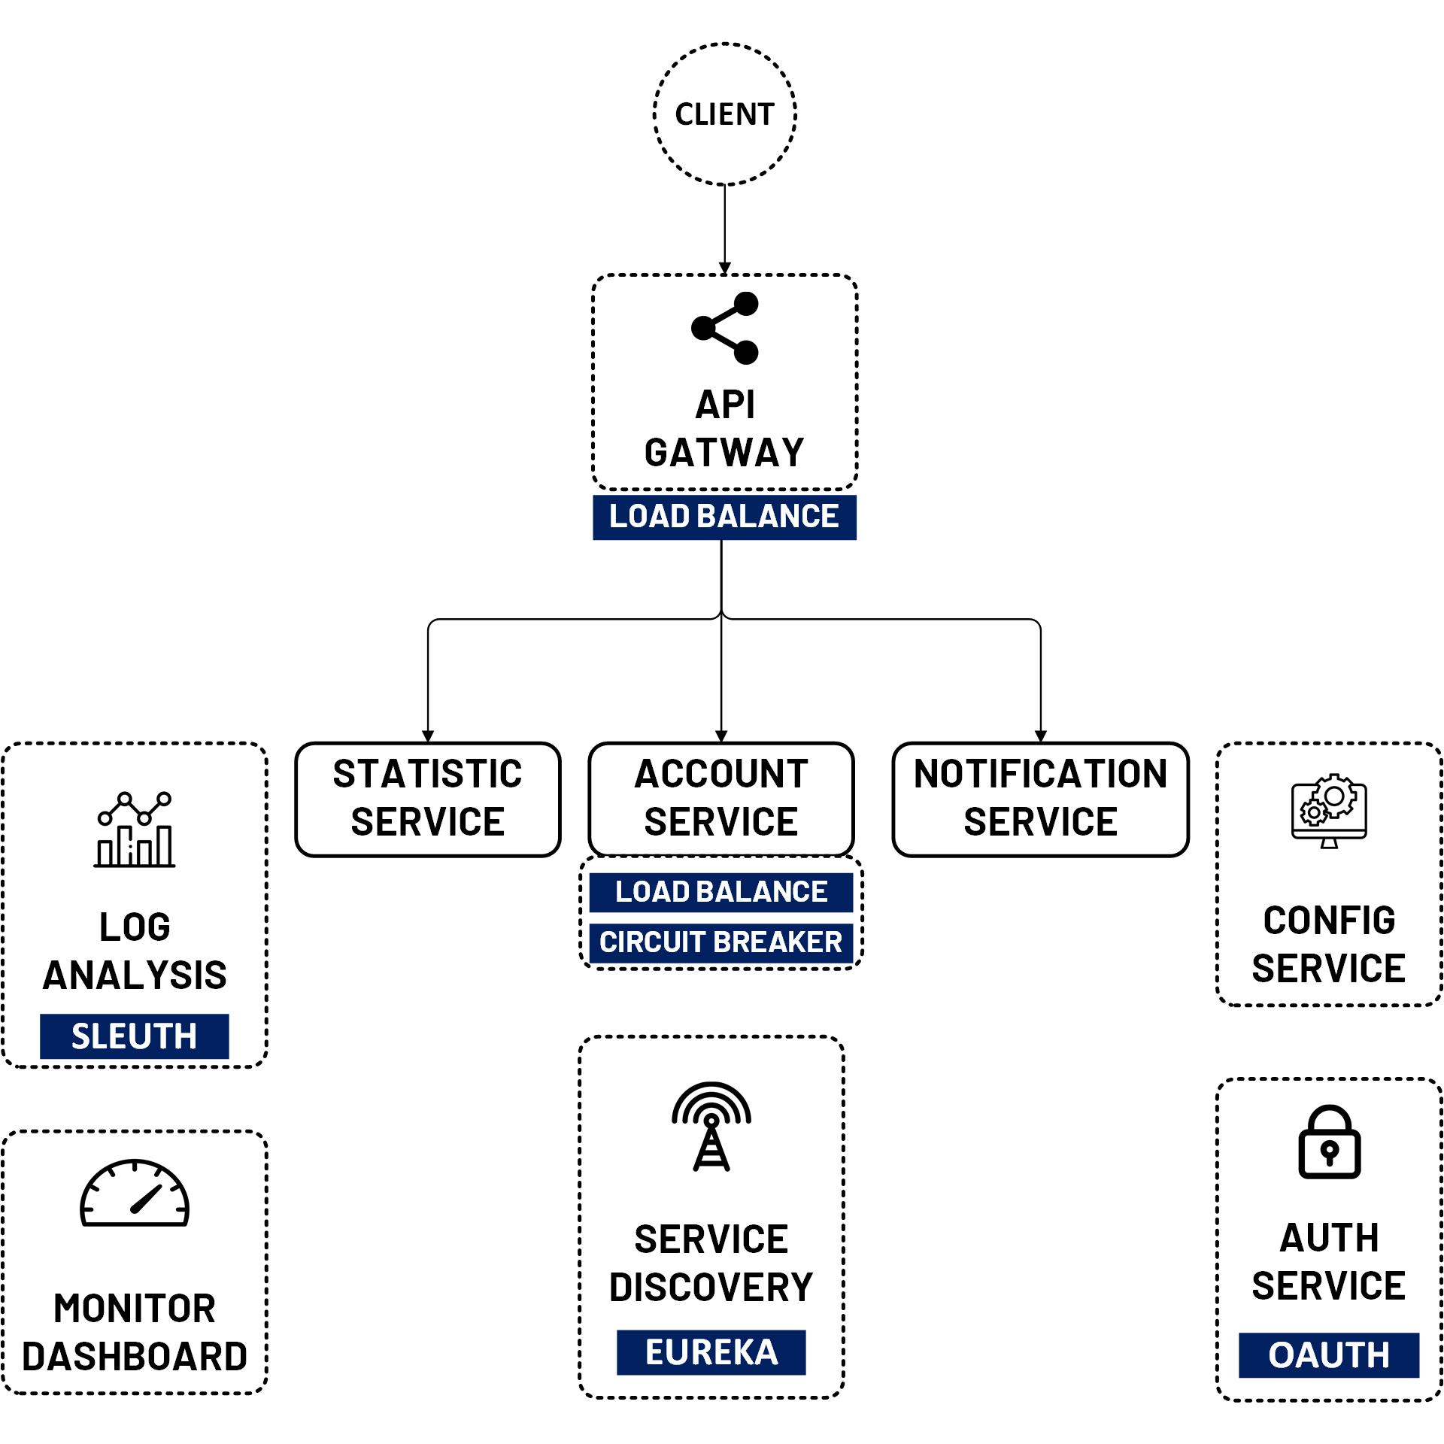

Admin Server Send Notification
www.jmaster.io/course/microservices-with-spring-cloud

